Slide 1
ECG-Based Abnormal Heartbeat Classification:
A Deep Learning Approach for Arrhythmia Detection

Slide 2
Objective
Problem:
Many diseases, such as Atrial Fibrillation, can be detected prematurely in Electrocardiograms (ECGs). Despite such information provided in ECGs, advancements have been limited in autonomous disease recognition in ECGs.
Purpose:
The purpose of this research project is to create a computer model capable of classifying heart arrhythmias to the accuracy of Physicians.
Question:
Is it possible to create a computer model capable of surpassing the accuracy of Physicians in identifying heart arrhythmias in Electrocardiograms (ECGs)?
Hypothesis:
It is possible to exceed the accuracy of a Physician when compared to that of a Convolutional Neural Network ‘s to classify heart arrhythmias in an Electrocardiograms (ECG).

Slide 3
Variables
Constants:
Training Data
Manipulated variable:
Hyper Parameters in the model
Layers in the model
Responding variable:
Loss and Accuracy of the model (measured by feeding a validation dataset into the trained model and comparing the predicted label for the ECG with the actual label of the ECG)

Slide 4
What is Deep Learning?
Deep Learning is a subclass of Machine Learning, which is inspired by a neuron’s structure, and function in the brain, groups of neurons are called Neural Networks. The first layer of a Neural Network is called the input layer, and is composed of neurons which represent the input data. A neuron holds a number (often between 0-1), the number corresponds to the activation of each neuron. The layers in the middle are hidden layers. These layers contain neurons which are responsible for identifying features within the dataset. The activations in neurons of each layer change to correctly predict the right class. The last layer of a Neural Network is called the output layer, which contains a neuron for each class in the dataset. Each neuron’s activation signifies the model’s certainty for that class. Hence, the largest activation in the output layer resembles the model’s most confident output.
Figure 1.1: Diagram of classes in Artificial Intelligence
Figure 1.2: Example Neural Network

Slide 5
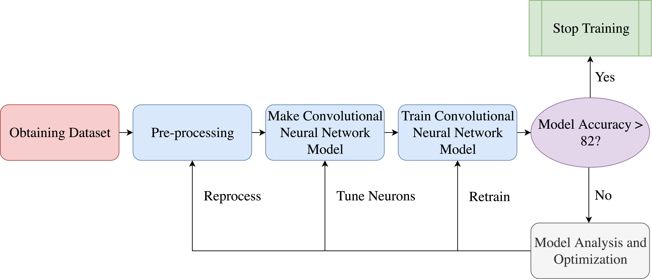
Methods

Slide 6
Database
The PhysioNet database contains 8,522 ECG recordings, divided into 4 classes: Normal, Atrial Fibrillation, Other, and Noisy. The raw data is provided in EFDB-compliant MATLAB V4 files, which including a .mat file containing the ECG recording and a .hea file containing the metadata for the recording.

Slide 7
Pre-processing Data
def zero_padding(self, ECG):
if len(ECG) > self.ECG_LENGTH:
return ECG[:self.ECG_LENGTH]
for _ in range(self.ECG_LENGTH-len(ECG)):
ECG.append(0)
return ECG
def rnd_zero(self, ECG):
for _ in range(np.random.randint(7)):
pos = abs(np.random.randint(abs(len(ECG)-11)))
dist = abs(np.random.randint(7))
ECG[pos:pos+dist]=[0]*dist
return ECG
def resampling(self, ECG):
MARGIN = 60
return signal.resample(ecg,
abs(np.random.randint(MARGIN)+(self.ECG_LENGTH-MARGIN)))
Pre-processing data
Randomize data
Normalizing data
Data augmentation
Zero Bursts - implementing random zeros in data to replace data with errors
Random Resampling - changing the sample rate of data collection to increase dataset size and avoid overfitting
https://www.geeksforgeeks.org/data-preprocessing-machine-learning-python/
This project was programed in Python 3.6, predominately object-oriented. The code ran on a cloud computing base called Colab which provided a Tesla K80 GPU with 12 GB of ram.

Slide 8
Data Augmentation
def zero_padding(self, ECG):
if len(ECG) > self.ECG_LENGTH:
return ECG[:self.ECG_LENGTH]
for _ in range(self.ECG_LENGTH-len(ECG)):
ECG.append(0)
return ECG
def rnd_zero(self, ECG):
for _ in range(np.random.randint(7)):
pos = abs(np.random.randint(abs(len(ECG)-11)))
dist = abs(np.random.randint(7))
ECG[pos:pos+dist]=[0]*dist
return ECG
def resampling(self, ECG):
MARGIN = 60
return signal.resample(ecg,
abs(np.random.randint(MARGIN)+(self.ECG_LENGTH-MARGIN)))
Pre-processing data
Randomize data
Normalizing data
Data augmentation
Zero Bursts - implementing random zeros in data to replace data with errors
Random Resampling - changing the sample rate of data collection to increase dataset size and avoid overfitting
https://www.geeksforgeeks.org/data-preprocessing-machine-learning-python/
This project was programed in Python 3.6, predominately object-oriented. The code ran on a cloud computing base called Colab which provided a Tesla K80 GPU with 12 GB of ram.

Slide 9
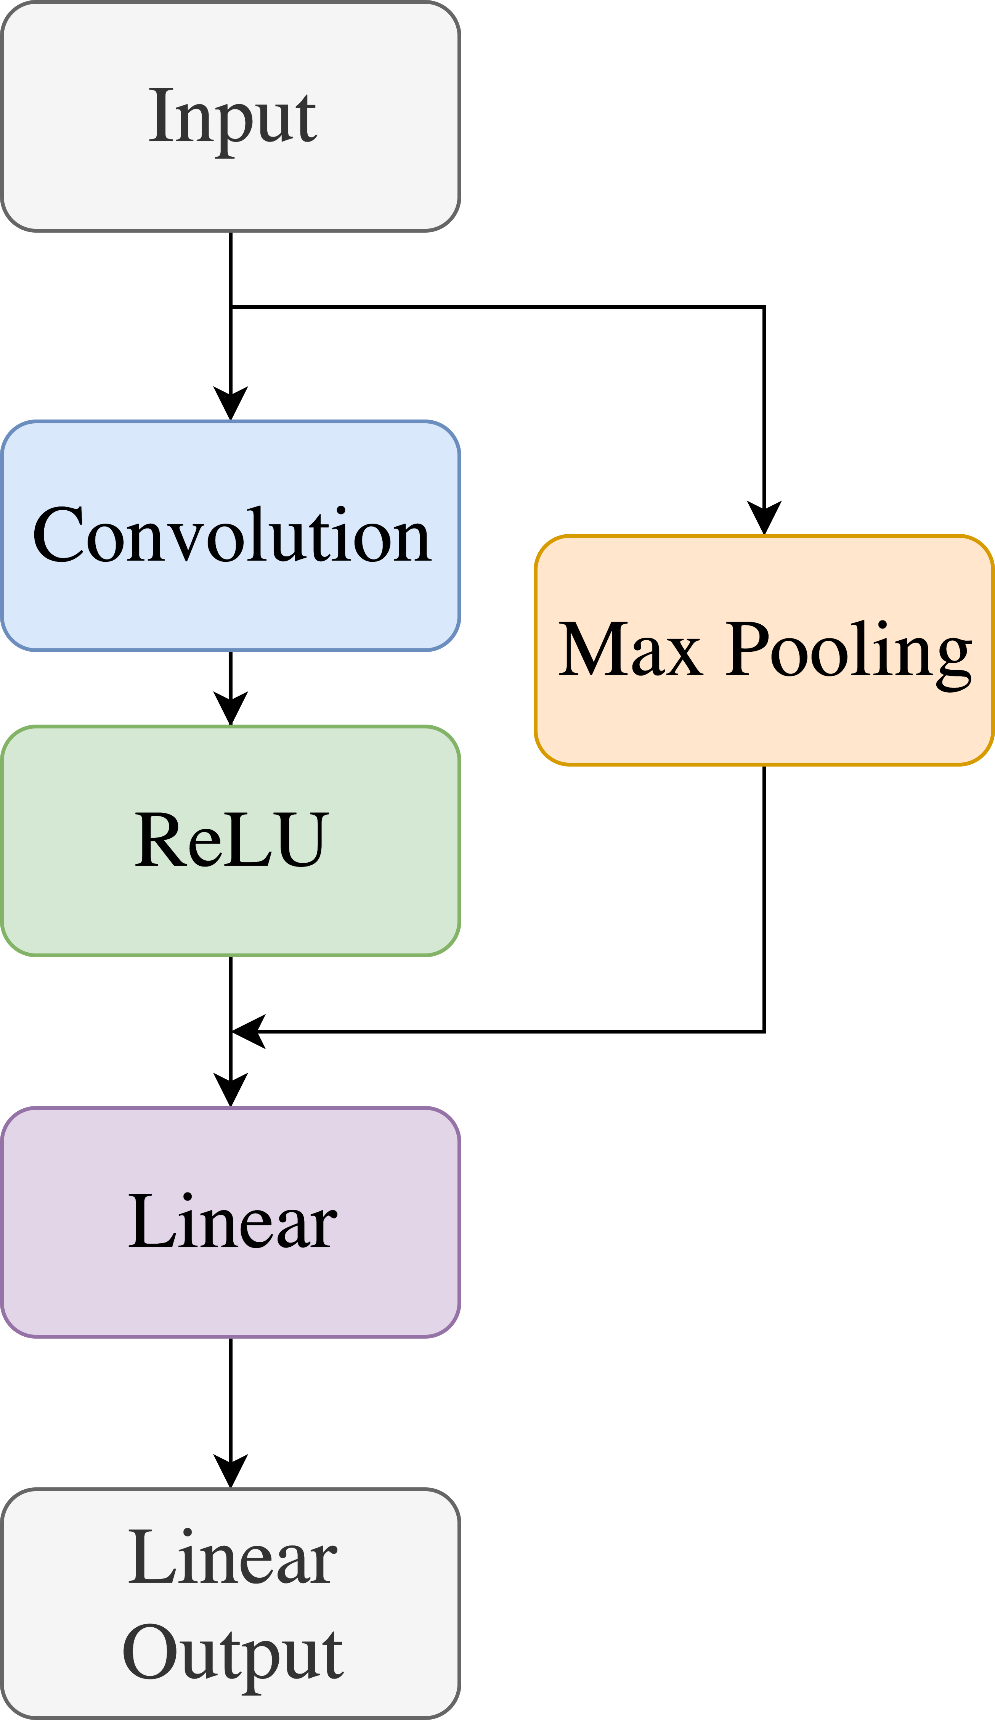
Convolutional Neural Network Model
The input consists of a 1-dimensional tensor (1x1x600) with a length of 600. The elements are normalized to values between 0 and 1.
class Net(nn.Module):
def __init__(self):
super().__init__()
self.conv1 = nn.Conv1d(1,180, 5, padding=2)
self.conv2 = nn.Conv1d(180, 150, 5, padding=2)
self.conv3 = nn.Conv1d(150, 120, 5, padding=2)
self.conv4 = nn.Conv1d(120, 90, 5, padding=2)
self.conv5 = nn.Conv1d(90, 45, 5, padding=2)
x = torch.randn(1,1,600).view(-1,1,600)
self._to_linear = None
self.convs(x)
self.fc1 = nn.Linear(self._to_linear, 64)
self.fc2 = nn.Linear(64, 4)
def convs(self, x):
x = F.max_pool1d(F.relu(self.conv1(x)), 3)
x = F.max_pool1d(F.relu(self.conv2(x)), 3)
x = F.max_pool1d(F.relu(self.conv3(x)), 3)
x = F.max_pool1d(F.relu(self.conv4(x)), 3)
x = F.max_pool1d(F.relu(self.conv5(x)), 3)
if self._to_linear is None:
self._to_linear = x[0].shape[0]*x[0].shape[1]
return x
def forward(self, x):
x = self.convs(x)
x = x.view(-1, self._to_linear)
x = F.relu(self.fc1(x))
x = self.fc2(x)
return x
Convoluting also decreases the size of the input vector. A vector (with a size of 1x5) filters across the data by producing all values in the vector by a filter vector. This method also assists the model in finding features.
Max Pooling reduces the size of the input, in the case of a 1D tensor. A kernel block (with a size of 1x3) filters over the 1D tensor. Taking the maximum value in the kernel block. This operation aids the model in finding features in the data.
x5
x5
The Rectified Linear activation function alters the range of the incoming data by setting all numbers below 0 to 0 and leaving all positive numbers intact.
x5
The liner function flattens the incoming result (1x135) into a 1D tensor (1x64).
The Linear Output layer transforms the Linear layer output into a 1x4. Each column in the tensor represents a class's likelihood of being the correct class in the dataset. Thus, the column with the largest values is the model prediction for the input.

Slide 10
Functions
explanation of difficult, unique and/or significant section(s) of the program.
Advantages / distagaves of optimizer and loss function
And what success looks like
https://ml-cheatsheet.readthedocs.io/en/latest/loss_functions.html
https://towardsdatascience.com/adam-latest-trends-in-deep-learning-optimization-6be9a291375c
https://pytorch.org/docs/stable/_modules/torch/nn/modules/loss.html

Slide 11
Loss and Accuracy
Without augmentation

Slide 12
Loss and Accuracy
Without augmentation

Slide 13
Loss and Accuracy
With augmentation

Slide 14
Loss and Accuracy
With augmentation

Slide 15
Augmentation
Accuracy vs augmentation graph

Slide 16
Accuracy
Accuracy of the model

Slide 17
Conclusions
Reject Hypothesis
Further research is need in development of both Algorithms
Datasets with more objects are needed
More computing power is needed in order to test more iterations of the HCA

Slide 18
Discussion
Reject Hypothesis
Further research is need in development of both Algorithms
Datasets with more objects are needed
More computing power is needed in order to test more iterations of the HCA

Slide 19
Further Exploration
Using PTB dataset with 12 nodes to get more infromation

Slide 20
Applications & Benefits

Slide 21
Figures
Figure 1:
Figure 1.1: | https://qph.fs.quoracdn.net/main-qimg-6dded2cfb527dd9f712d0e9da15c9d6f
Figure 1.2: | Dixon, M., Mlabjan, D., & Bang, J. H. (2017, December 21). Deep Learning Digram [Digital image]. Retrieved from https://content.iospress.com/media/af/2017/6-3-4/af-6-3-4-af176/af-6-af176-g001.jpg?width=755
Figure 1.3:
Figure 1.4:
Figure 1.5:
Figure 1.6:
Figure 1.7:
Figure 1.8:
Figure 1.9:
Figure 2:
Figure 2.1:

Slide 22
References
Alfaras, Miquel, Soriano, & Silvia. (2019, July 3). A Fast Machine Learning Model for ECG-Based Heartbeat Classification and Arrhythmia Detection. Retrieved October 30, 2019, from https://www.frontiersin.org/articles/10.3389/fphy.2019.00103/full.
Mayo Clinic. (2019, April 2). Heart arrhythmia. Retrieved October 30, 2019, from https://www.mayoclinic.org/diseases-conditions/heart-arrhythmia/symptoms-causes/syc- 20350668?utm_source=Google&utm_medium=abstract&utm_content=Cardiac- arrhythmia&utm_campaign=Knowledge-panel.
Srinivasan, N. T., & Schilling, R. J. (2018, June). Sudden Cardiac Death and Arrhythmias. Retrieved October 30, 2019, from https://www.ncbi.nlm.nih.gov/pmc/articles/PMC6020177/.
Horton LA, Mosee S, Brenner J. Use of the electrocardiogram in a
pediatric emergency department. Arch Pediatr Adolesc Med. 1994;
148:184-188.
Kuhn M, Morgan MT, Hoffman JR. Quality assurance in the
emergency department: evaluation of the ECG review process. Ann
Emerg Med. 1992;21:18-23.
Westdorp EJ, Gratton MC, Watson WA. Emergency department
interpretation of electrocardiograms. Ann Emerg Med. 1992;21:
541-544.
Todd KH, Hoffman JR, Morgan MT. Effect of cardiologist ECG review
on emergency medicine practice. Ann Emerg Med. 1996;27:16-21.
Johnson K. The Harriet Lane Handbook. 13th ed. St. Louis, MO:
Mosby; 1993:101.

Slide 23
References
Awerdich. (2020, January 5). awerdich/physionet. Retrieved from https://github.com/awerdich/physionet
Awni. (2019, January 15). awni/ecg. Retrieved from https://github.com/awni/ecg
Brownlee, J. (2019, December 19). What is Deep Learning? Retrieved from https://machinelearningmastery.com/what-is-deep-learning/
Brownlee, J. (2019, August 6). A Gentle Introduction to the Rectified Linear Unit (ReLU). Retrieved from https://machinelearningmastery.com/rectified-linear-activation-function-for-deep-learning-neural-networks/
Bushaev, V. (2018, October 24). Adam - latest trends in deep learning optimization. Retrieved from https://towardsdatascience.com/adam-latest-trends-in-deep-learning-optimization-6be9a291375c
C-Labpl. (2018, April 30). c-labpl/qrs_detector. Retrieved from https://github.com/c-labpl/qrs_detector
Cao, P., Li, X., Mao, K., Lu, F., Ning, G., Fang, L., & Pan, Q. (2020). A novel data augmentation method to enhance deep neural networks for detection of atrial fibrillation. Biomedical Signal Processing and Control, 56, 101675. doi: 10.1016/j.bspc.2019.101675
Convolutional Neural Networks (LeNet). (n.d.). Retrieved from http://deeplearning.net/tutorial/lenet.html
CVxTz. (2019, May 17). CVxTz/ECG_Heartbeat_Classification. Retrieved from https://github.com/CVxTz/ECG_Heartbeat_Classification
Gao, X. (2019, April 3). Diagnosing Abnormal Electrocardiogram (ECG) via Deep Learning. Retrieved from https://www.intechopen.com/online-first/diagnosing-abnormal-electrocardiogram-ecg-via-deep-learning
Gao, X. (2019). Diagnosing Abnormal Electrocardiogram (ECG) via Deep Learning. Electrocardiography [Working Title]. doi: 10.5772/intechopen.85509
Huang, L., Pan, W., Zhang, Y., Qian, L., Gao, N., & Wu, Y. (2020). Data Augmentation for Deep Learning-Based Radio Modulation Classification. IEEE Access, 8, 1498–1506. doi: 1912.03026
Krylatov-Pavel. (2019, August 19). krylatov-pavel/aibolit-ECG. Retrieved from https://github.com/krylatov-pavel/aibolit-ECG
Pyakillya, B., Kazachenko, N., & Mikhailovsky, N. (2017). Deep Learning for ECG Classification. Journal of Physics: Conference Series, 913, 012004. doi: 10.1088/1742-6596/913/1/012004
Sakai, A., Minoda, Y., & Morikawa, K. (2017). Data augmentation methods for machine-learning-based classification of bio-signals. 2017 10th Biomedical Engineering International Conference (BMEiCON). doi: 10.1109/bmeicon.2017.8229109
Skalski, P. (2019, January 4). Preventing Deep Neural Network from Overfitting. Retrieved from https://towardsdatascience.com/preventing-deep-neural-network-from-overfitting-953458db800a
Wathen, J. E., Rewers, A. B., Yetman, A. T., & Schaffer, M. S. (2005). Accuracy of ECG Interpretation in the Pediatric Emergency Department. Annals of Emergency Medicine, 46(6), 507–511. doi: 10.1016/j.annemergmed.2005.03.013
Zhang, X.-R., Lei, M.-Y., & Li, Y. (2018). An Amplitudes-Perturbation Data Augmentation Method in Convolutional Neural Networks for EEG Decoding. 2018 5th International Conference on Information, Cybernetics, and Computational Social Systems (ICCSS). doi: 10.1109/iccss.2018.8572304
Zhang, Z., Duan, F., Sole-Casals, J., Dinares-Ferran, J., Cichocki, A., Yang, Z., & Sun, Z. (2019). A Novel Deep Learning Approach With Data Augmentation to Classify Motor Imagery Signals. IEEE Access, 7, 15945–15954. doi: 10.1109/access.2019.2895133
Zihlmann, M., Perekrestenko, D., & Tschannen, M. (2017). Convolutional Recurrent Neural Networks for Electrocardiogram Classification. 2017 Computing in Cardiology Conference (CinC). doi: 10.22489/cinc.2017.070-060
Alfaras, Miquel, Soriano, & Silvia. (2019, July 3). A Fast Machine Learning Model for ECG-Based Heartbeat Classification and Arrhythmia Detection., from https://www.frontiersin.org/articles/10.3389/fphy.2019.00103/full.
Mayo Clinic. (2019, April 2). Heart arrhythmia. Retrieved October 30, 2019, from https://www.mayoclinic.org/diseases-conditions/heart-arrhythmia/symptoms-causes/syc- 20350668?utm_source=Google&utm_medium=abstract&utm_content=Cardiac- arrhythmia&utm_campaign=Knowledge-panel.
Srinivasan, N. T., & Schilling, R. J. (2018, June). Sudden Cardiac Death and Arrhythmias. Retrieved October 30, 2019, from https://www.ncbi.nlm.nih.gov/pmc/articles/PMC6020177/.

Slide 24
Presenter RARELY looked

